Slide 1
For the sake of energy stability and energy saving ,AEMR should build a provider reliability evaluation metric ( e.g. # of outage events, duration time, energy loss) to define a market standard, mitigate Forced Outage, and identify reliable energy providers.
1. Outage happens every month (>160) and even every day (>5). The outage number is getting higher year by year.
2. Forced Outage is the main problem with respect to the high percentage of total outage events (>65%), longer average duration, big fluctuation and increasing outage number over the year.
3. The good news: Even though average duration is increasing by 20% from 2016 to 2017, the energy loss drops by 12.8%.
4. Considering four indices (total number of outage events, average duration time, average and summed energy loss), MELK, GW and PJRH are most unreliable providers. COLLGAR AND ENRG should be on the unreliable list too.

Slide 2
Outage happens every month (>160) and almost everyday (>5). February is a peak for 2016, as October for 2017. Energy is more unstable in 2017, in which the number of market outage events keeps increasing from March to August.

Slide 3
Forced Outage is the major issue in terms of percentage of total outage events (>65%) and average duration (>0.5 days).

Slide 4
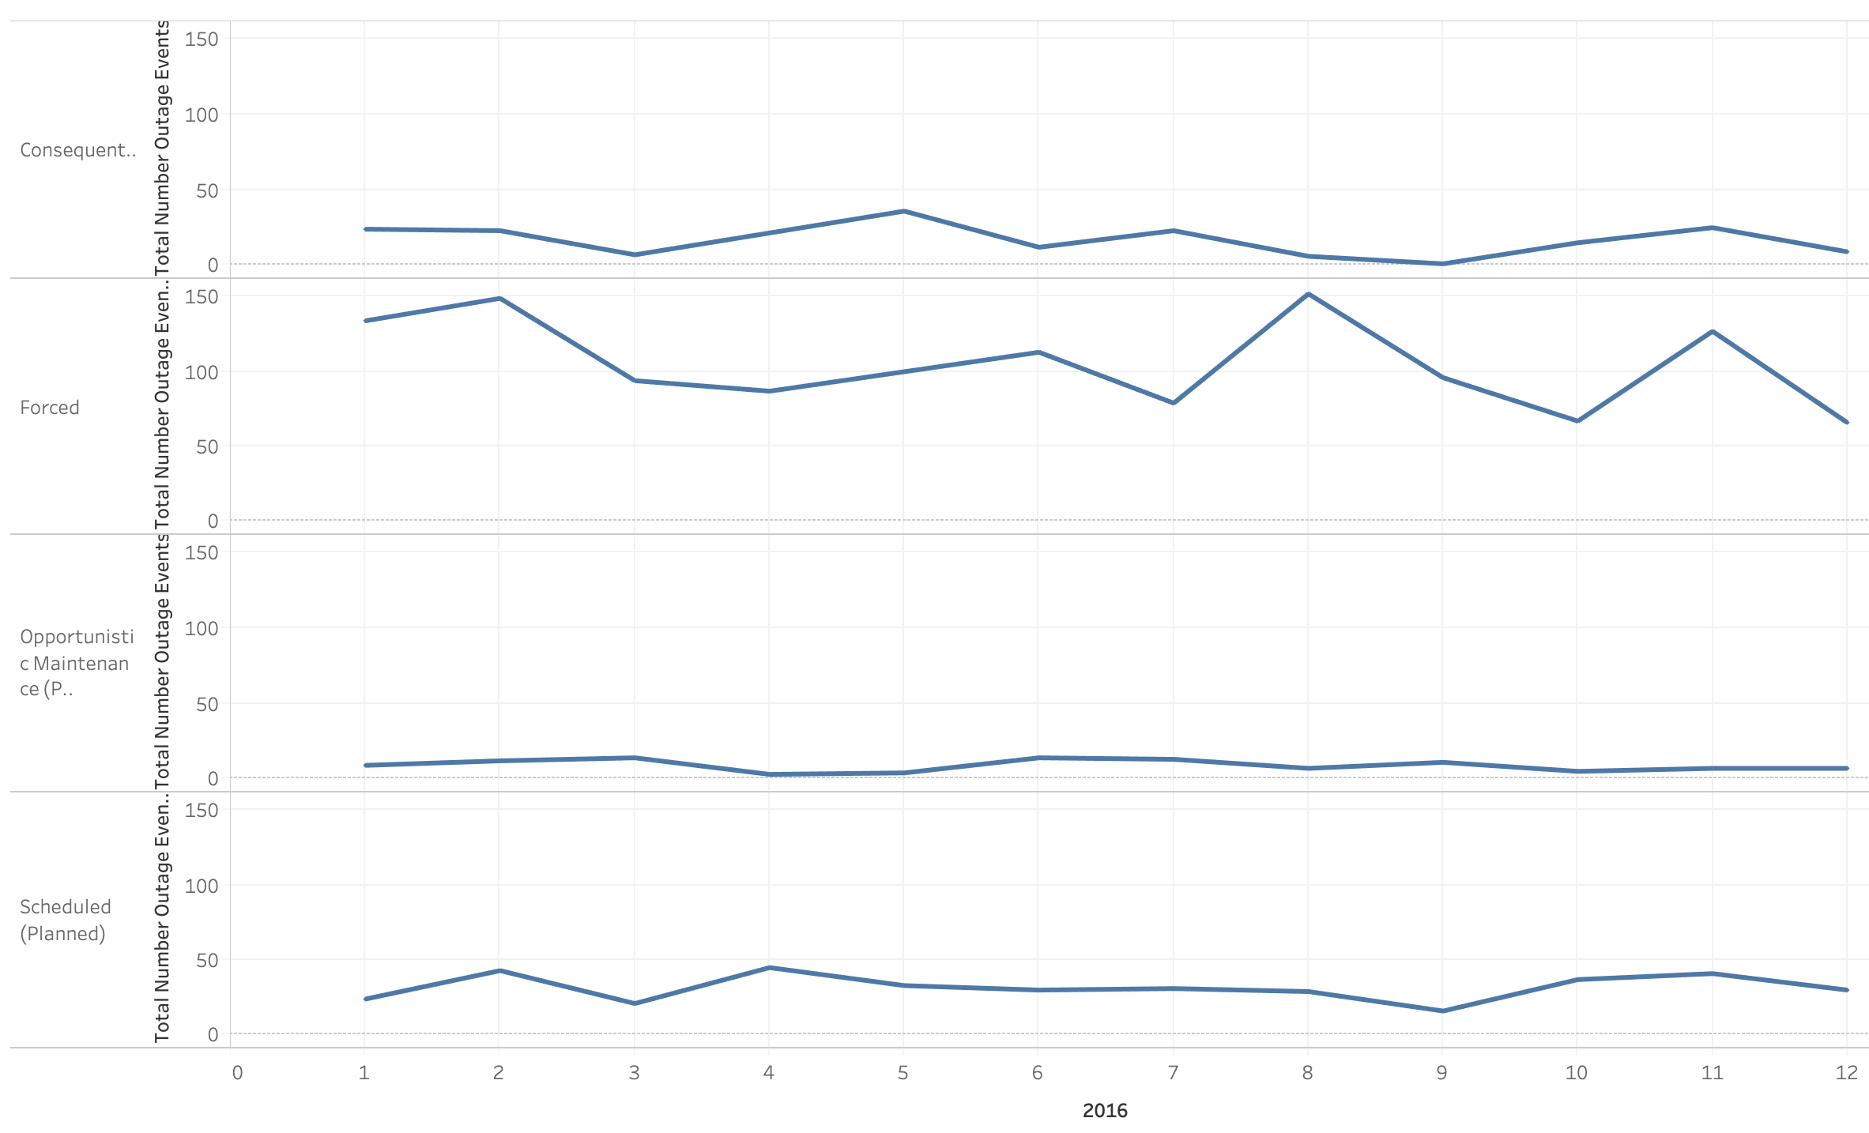
Among all types of outage, Forced Outage is the highest one and fluctuates the most. That means Forced Outage brings the most energy instability and should be regulated closely.

Slide 5
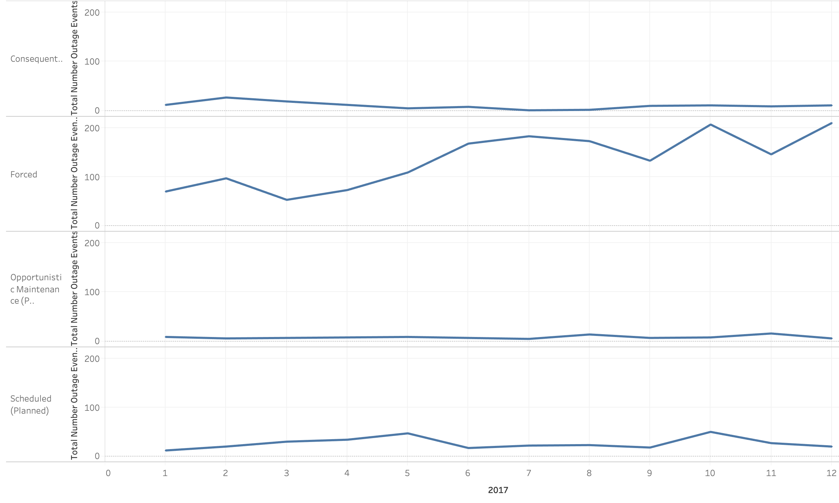
The number of Forced Outage keeps increasing from 2016 to 2017 and creates more uncertainties in the energy market.

Slide 6
The overall average duration time increases by 20% (Forced Outage increases by 40.7%) from 2016 to 2017, but the average energy loss decreases by 12.8% (Forced Outage decrease by 9.1%).

Slide 7
MELK, GW and PJRH are most unreliable providers in terms of total number outage events and average outage duration time.

Slide 8
COLLGAR also should be considered unreliable, since its outage causes most energy loss. ENRG is unreliable too, due to the longest average duration time.

